Slide 1

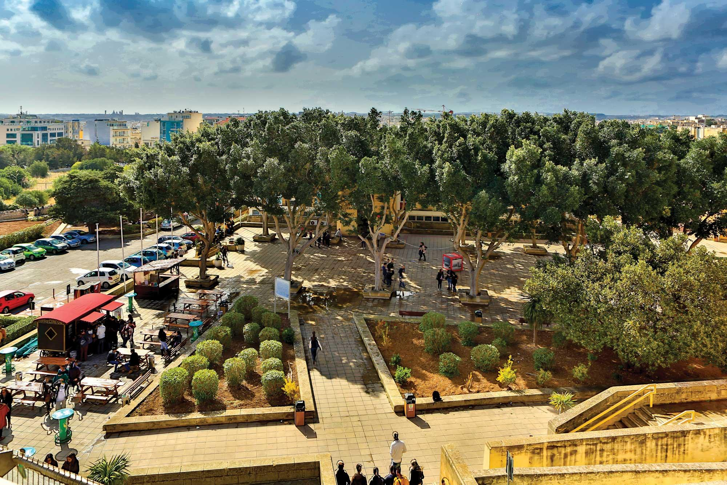





Nov 2026 - University of Crete
Machine Learning for Bioinformatics
Day 2
Neural Networks
Panagiotis Alexiou, PhD
University of Malta

Slide 2
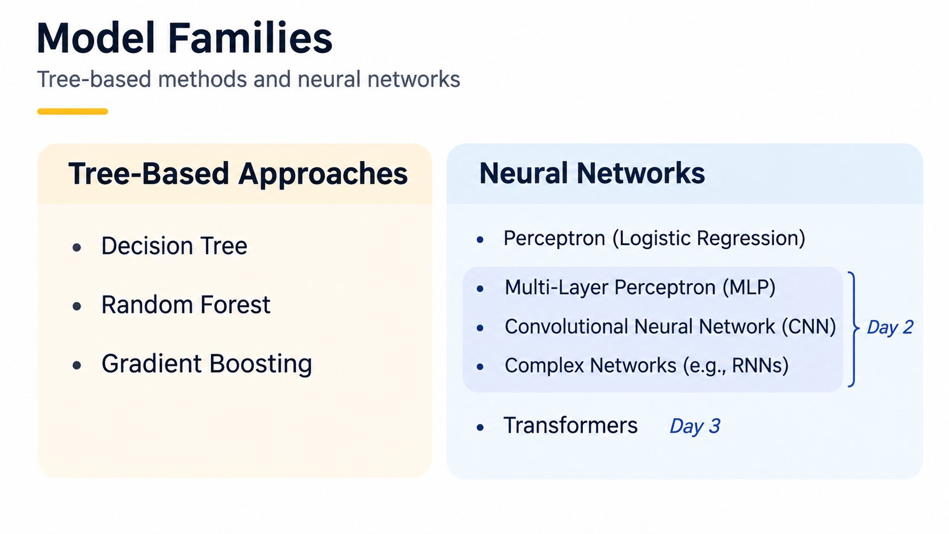


Slide 3
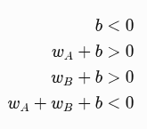
Exclusive OR regulation
————————————————————— :: 0 == no response
————— AAAAAAA ——————————— :: 1 == response
——————————— BBBBBBB ————— :: 1 == response
————— AAAAAAA ——BBBBBBBB———— :: 0 == no response
(this is a XOR - exclusive OR)
Can a ‘bag of k-mers’ represent the sequences?
Can a ‘perceptron’ represent the relationship?
What about a tree based approach?

Slide 4
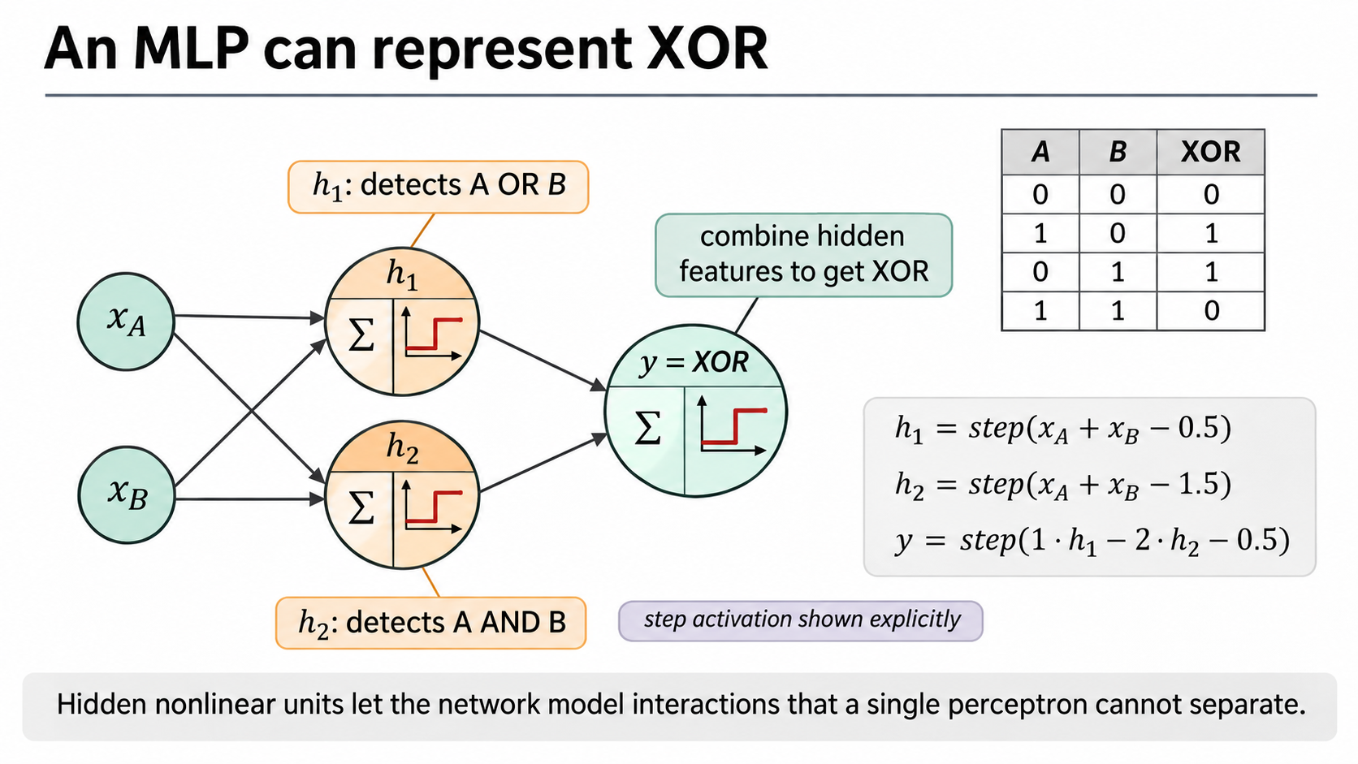

Slide 5
How do we learn these?

Slide 6
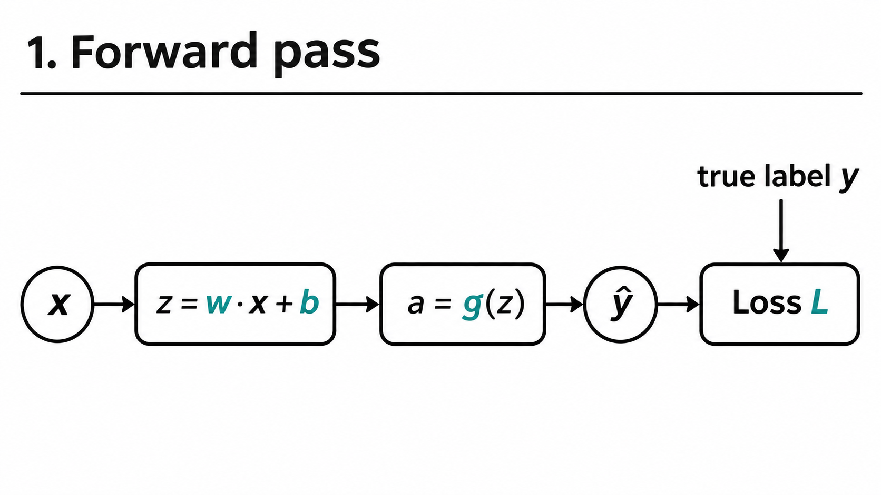

Slide 7
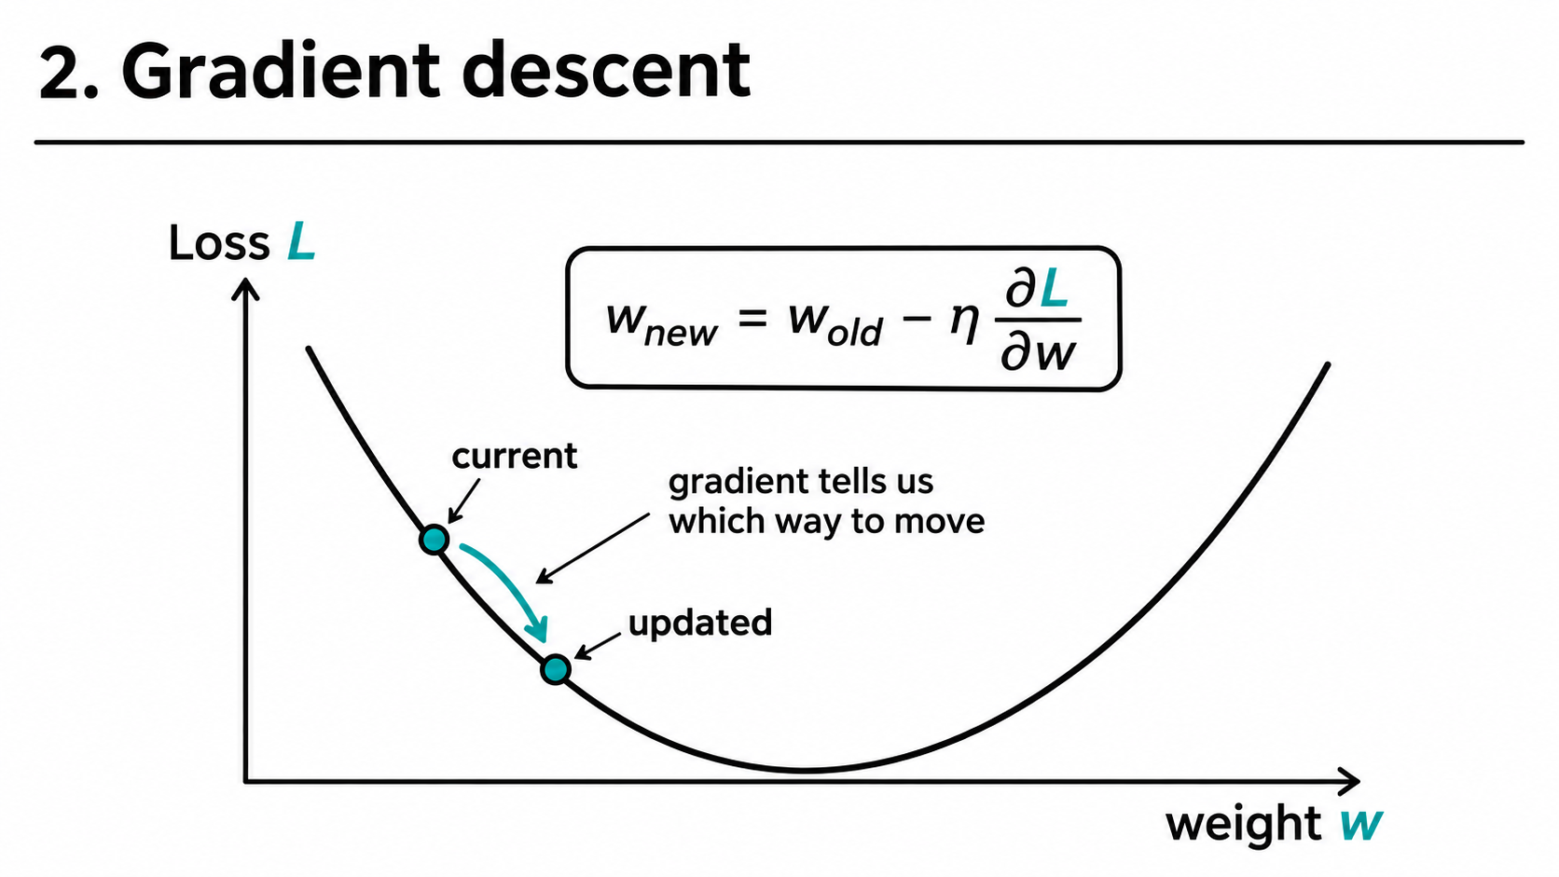

Slide 8
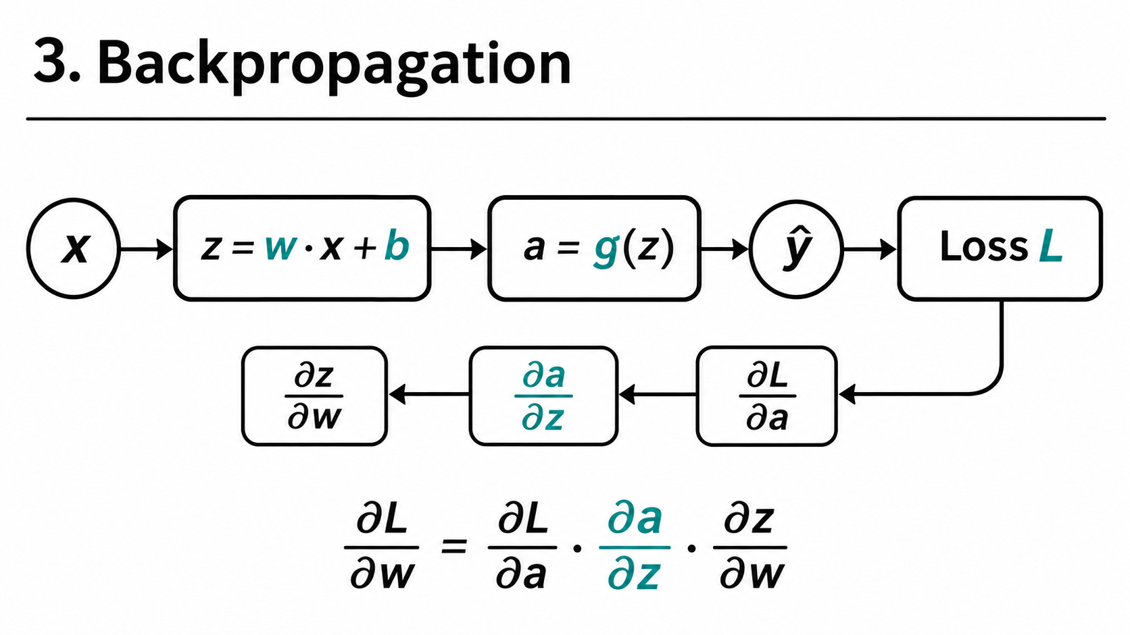

Slide 10
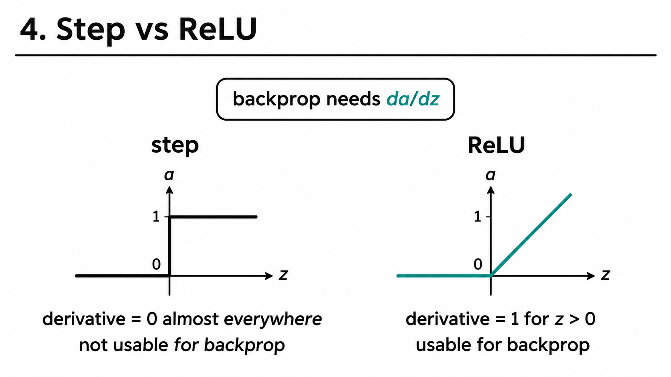
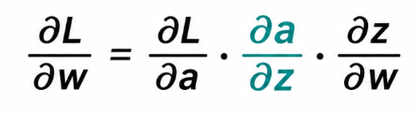

Slide 11
Exercise 7
Solve an XOR motif:
Single Neuron Perceptron
Random Forest
Multi Layered Perceptron (ReLU)

Slide 12
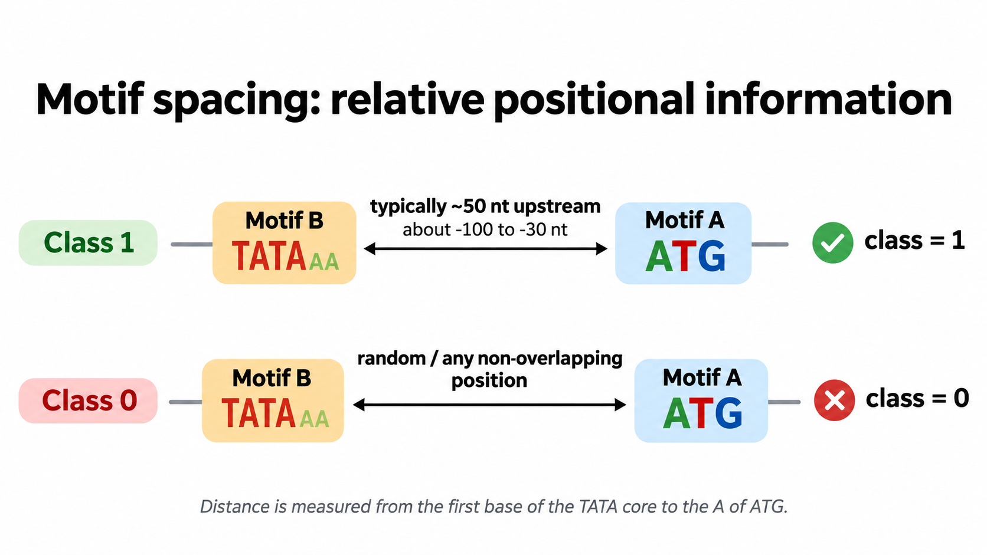

Slide 13
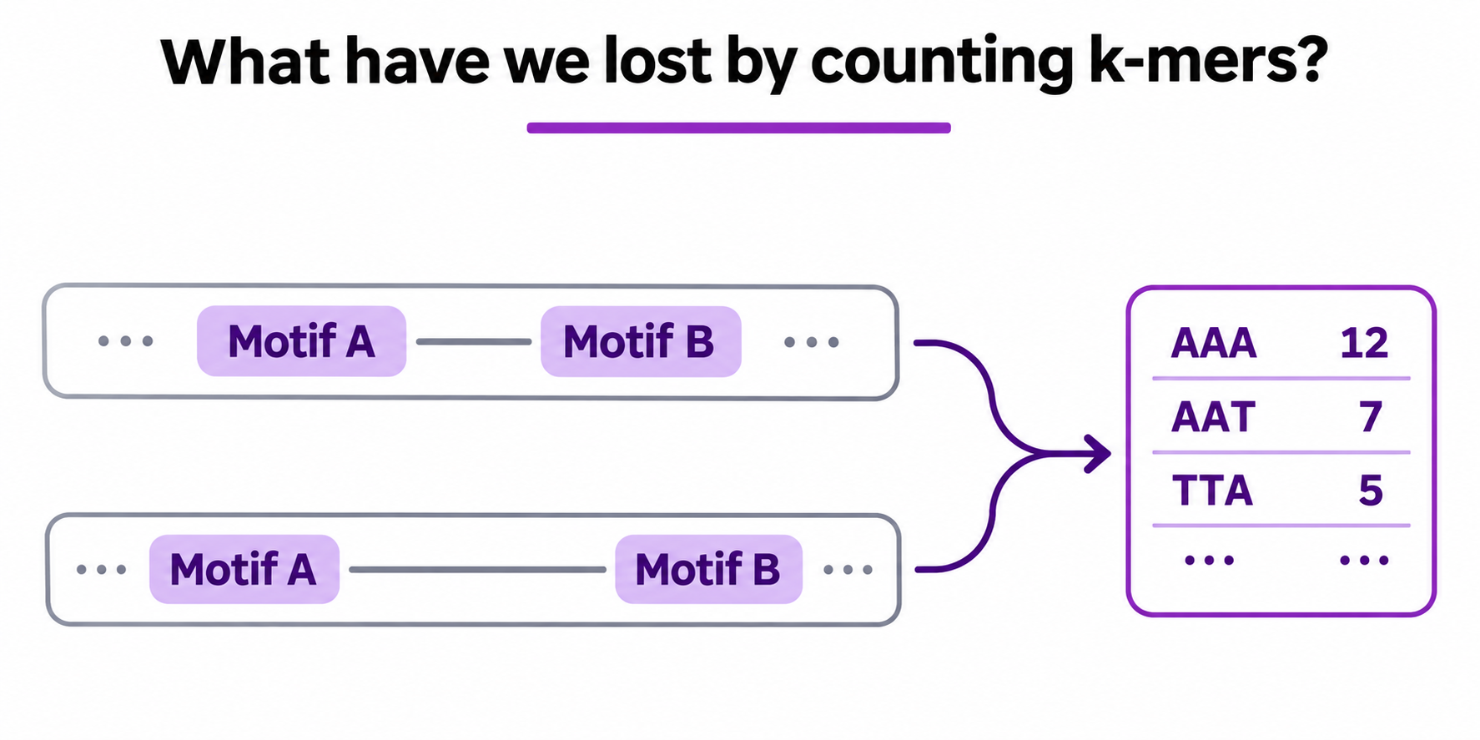

Slide 14
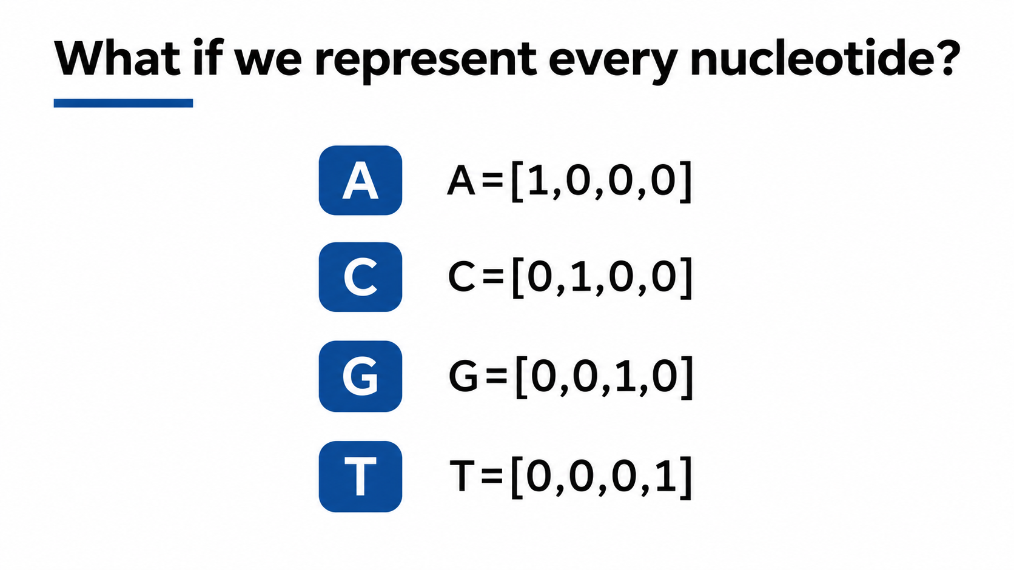

Slide 15
One-hot encoding DNA
1,000-nt DNA sequence
A
C
G
T
T
A
T
A
A
C
G
T
A
G
A
1
0
0
0
0
1
0
1
1
0
0
0
1
0
C
0
1
0
0
0
0
0
0
0
1
0
0
0
0
Four nucleotide channels
G
0
0
1
0
0
0
0
0
0
0
1
0
0
1
T
0
0
0
1
1
0
1
0
0
0
0
1
0
0
4 × 1,000

Slide 16
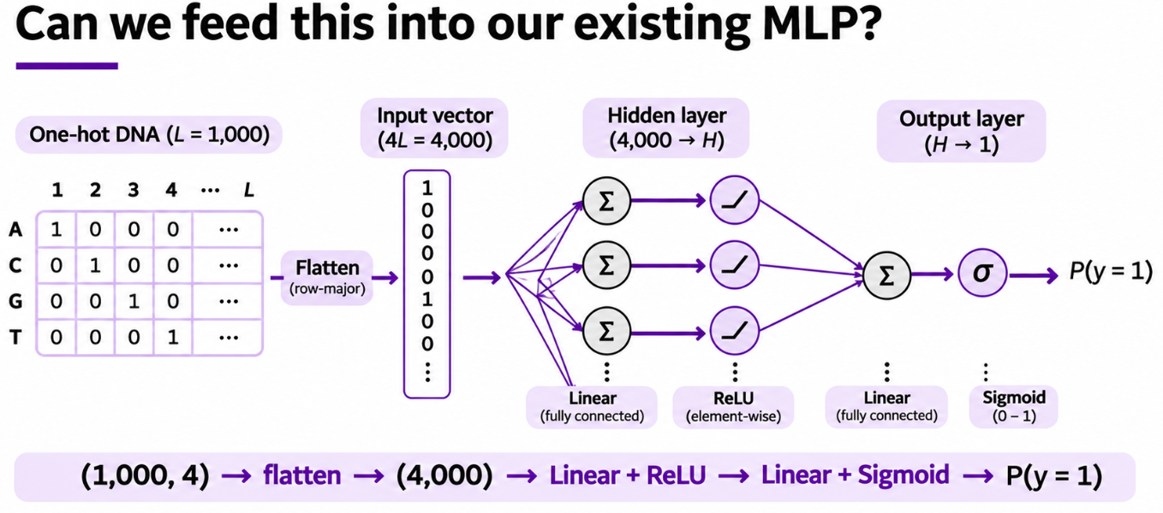

Slide 17
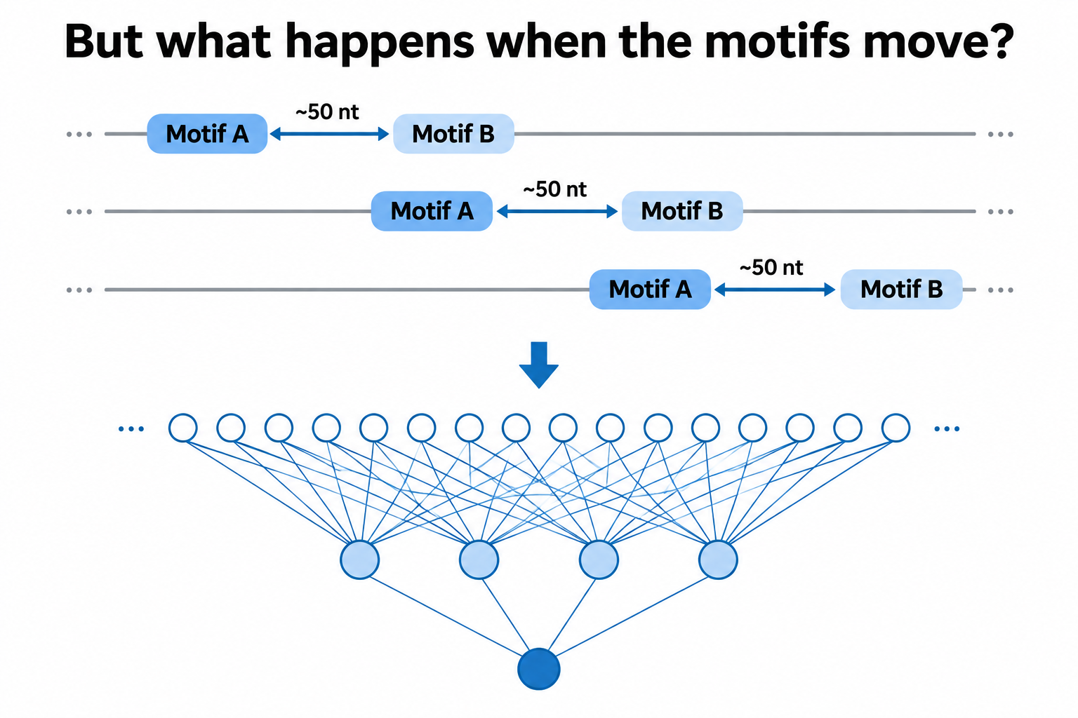

Slide 18
1. Our starting point: one-hot DNA
1,000-nt DNA sequence
A
C
G
T
T
A
T
A
A
C
G
T
A
G
A
1
0
0
0
0
1
0
1
1
0
0
0
1
0
C
0
1
0
0
0
0
0
0
0
1
0
0
0
0
Four nucleotide channels
G
0
0
1
0
0
0
0
0
0
0
1
0
0
1
T
0
0
0
1
1
0
1
0
0
0
0
1
0
0
4 × 1,000

Slide 19
2. A motif is a local pattern
G
A
C
G
C
T
A
G
T
T
T
A
A
T
T
A
A
T
T
A
A
A
A
G
G
C
C
T
T
C
T
A
G
C
A
G
T
T
A
G
G
A
10-nt motif

Slide 20
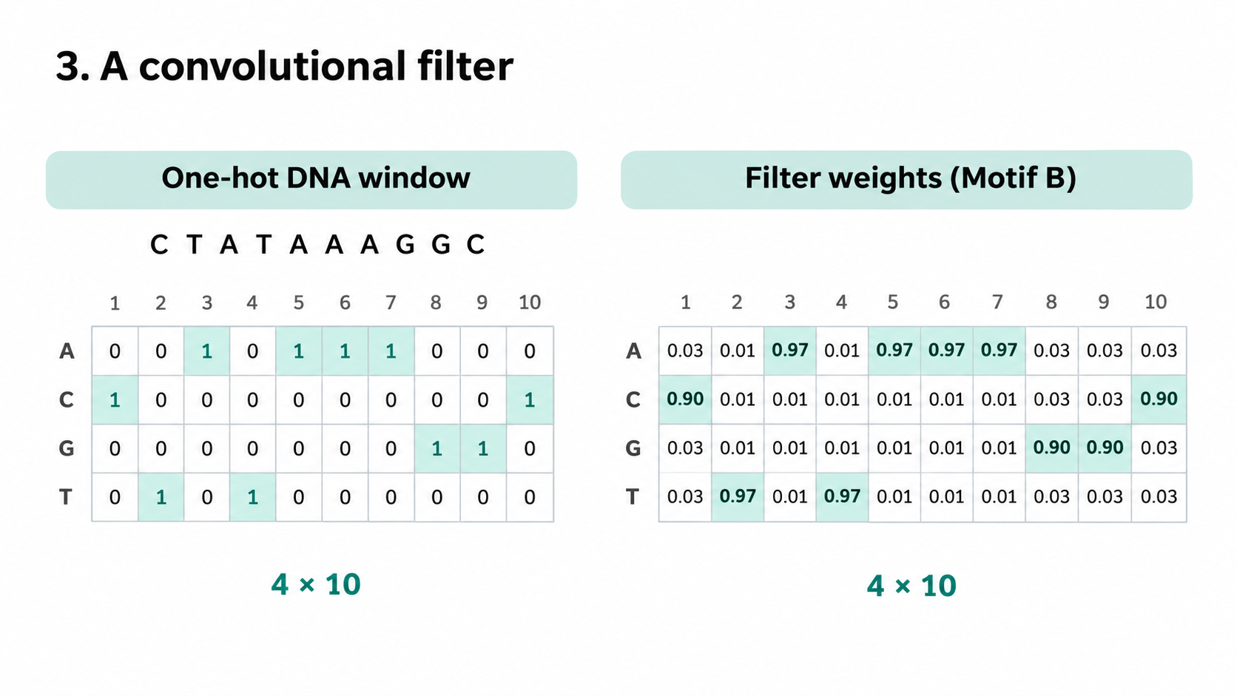

Slide 21
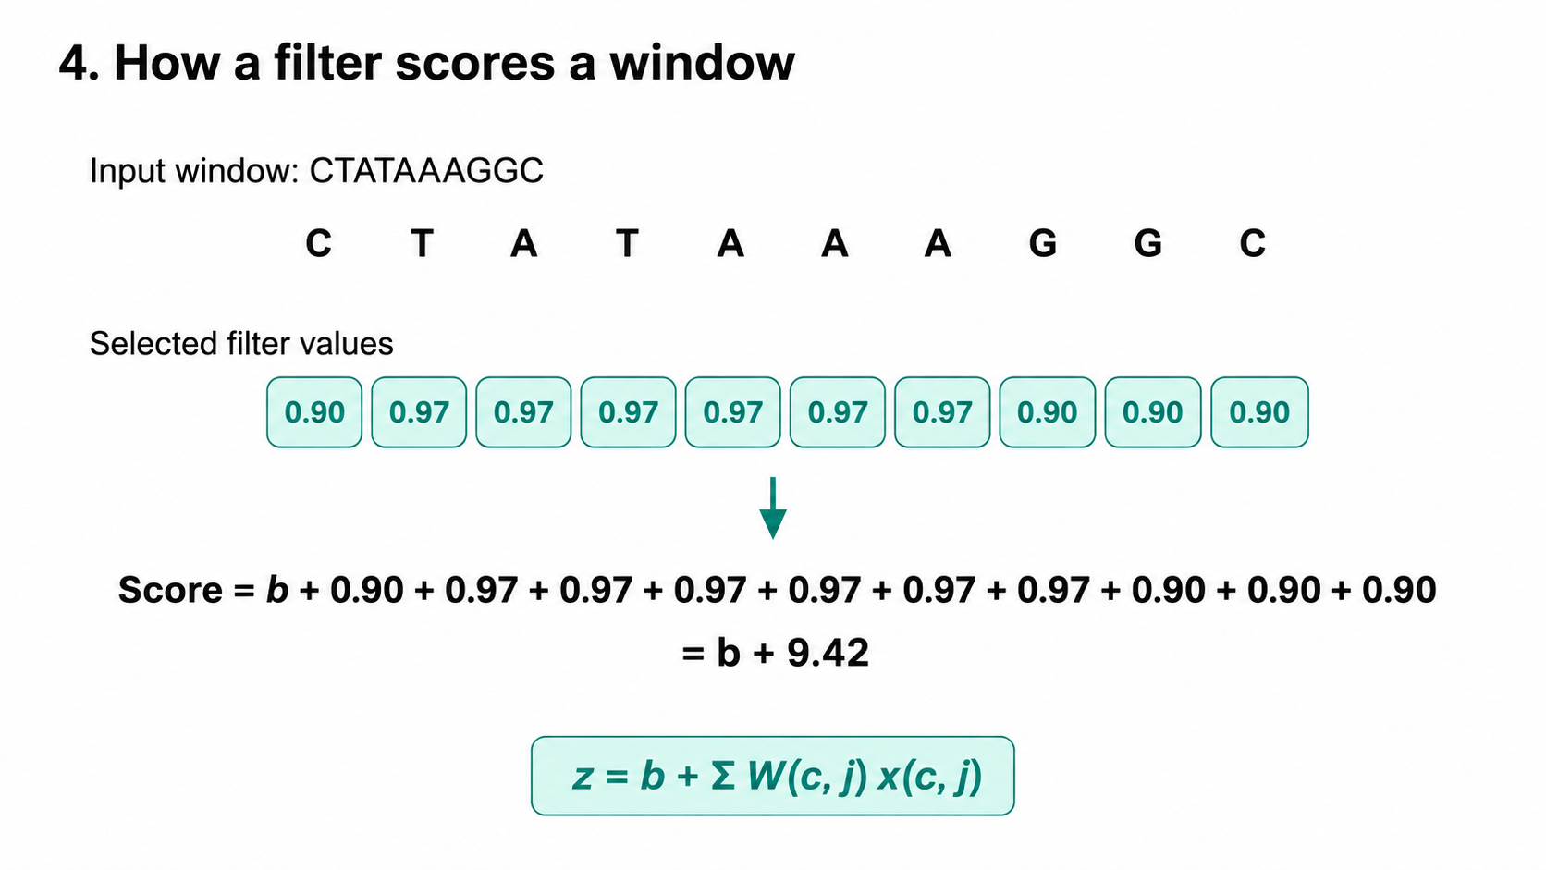

Slide 22
5. Sliding the filter
A
T
G
C
T
A
C
G
T
A
C
G
T
G
Window 1 (start 1)
A
T
G
C
T
A
C
G
T
A
C
G
T
G
Window 2 (start 2)
A
T
G
C
T
A
C
G
T
A
C
G
T
G
Window 3 (start 3)
One set of weights scores every window.

Slide 23
6. From scores to a motif-response map
DNA
G
C
T
A
C
T
G
A
C
A
T
G
C
T
A
C
G
T
A
T
C
C
A
G
G
T
A
A
G
C
0
0
0
0
0
0
0
0
0
0
3
0
0
0
0
0
0
0
0
0
0
Activation after ReLU
Strong response at the matching window

Slide 24
7. Two filters, two motifs
One input sequence
Motif A
Motif B
Filter A →
Filter B →
Two aligned positional response maps
2 × 991 scores per sequence

Slide 25
8. ReLU keeps positive motif responses
-1.2
-0.7
0.4
2.1
-0.3
0
1.3
-1.1
Raw filter scores (after bias)
ReLU(z) = max(0, z)
After ReLU
0
0
0.4
2.1
0
0
1.3
0
Negative scores become zero; positive scores keep their magnitude.

Slide 26
9. Local max pooling: keep the strongest response
Four positions
Four positions
Final partial bin
0
0.2
1.8
0.3
0.2
0.1
0
2.4
…
0.3
0
1.1
1.8
2.4
1.1
2 × 991 → 2 × 248

Slide 27
10. Why not global max pooling yet?
A close to B
Motif A
max A = 3
max B = 2.5
Motif B
A far from B
Motif A
max A = 3
max B = 2.5
Motif B
Different spacing → identical maxima
Notes:
Global max pooling finds the strongest response for each motif, irrespective of its position. Even when the A–B spacing differs, the vector of maxima can be identical. This is why global pooling is delayed until after the trainable convolution learns local arrangements. Values are schematic.

Slide 28
11. Two channels preserve motif positions
Motif A
Relative offset
Motif B
Two aligned feature maps · 2 × 248
Notes:
Local max pooling retains coarse position. Each of the two channels is a sequence of 248 values; responses are aligned in pooled position. A filter in the next layer can examine both channels within a common window.

Slide 29
12. A second convolution combines the motifs
A
score
B
31 pooled positions
One filter weighs both channels at each offset in its window.
Notes:
A kernel of width 31 has a separate weight for each offset in each of the two input channels, so its shape is 2 × 31. It can learn that an A response should occur earlier in the window than a B response. One window returns one scalar score; sliding returns an entire output feature map.

Slide 30
13. Receptive field: how much DNA is visible?
First PWM filter
10 nt
One pooled value
13 nt
Second conv (31 bins)
133 nt
10 + 3 + 30 × 4 = 133 nt
Notes:
The width-10 first convolution sees 10 DNA bases. Max pooling over 4 adjacent stride-1 convolution positions expands a pooled value’s receptive field to 10+3=13 bases. The width-31 second convolution examines 31 pooled outputs, which are stepped 4 bases apart: 13 + (31−1)×4 = 133 nt. This is a maximum contiguous input span, not an assertion that every filter uses all positions equally.

Slide 31
14. Padding keeps the second map the same length
Zero-padded feature map
15 zeros
248 pooled positions
15 zeros
Kernel width 31
Padding 15 on each side → output length 248
Notes:
The second convolution has kernel size 31 and padding 15 at each end, with stride 1. Its output length is 248 + 2×15 − 31 + 1 = 248. The padded values are artificial zeros in activation space, not additional DNA nucleotides.

Slide 32
15. Sixteen filters learn different arrangements (Conv 2)
Two motif channels
16 filters
2 × 31 weights each
⋮
16 output maps
2 × 248 → 16 × 248
Notes:
The learned convolution has 16 output filters. Every filter observes both input channels over 31 pooled positions, and creates its own positional response map. With padding 15, each map retains 248 positions. Feature maps may respond to different motif spacings, orderings or combinations; these interpretations are not guaranteed.

Slide 33
16. Global max pooling — now we can discard position
16 learned feature maps
0
0.1
0.2
2.8
0.4
0.2
0
0
0
0
map 1
max per map
0
0.3
0
0.6
0.2
1.9
0.1
0
0.2
0.1
map 2
[2.8, 1.9, 1.4, …]
0.1
0.2
1.4
0.4
0.1
0
0.1
0.2
0
0.2
map 3
16 numbers
⋮
The pattern has already been combined; location can now be ignored.
Notes:
Global max pooling takes one strongest score from each of the 16 learned feature maps, giving a length-16 vector. At this point, the filters can already have combined evidence about motif order and spacing within their receptive fields. The final prediction becomes less sensitive to where the learned arrangement occurs. Values are schematic.

Slide 34
17. From sixteen values to a probability
16 pooled values
Linear
Sigmoid(z)
[2.8, 1.9, …]
logit z
P(class 1)
Example: z = 0.4 → P(class 1) ≈ 0.60
Notes:
The 16 pooled features enter one linear output layer, producing one real-valued logit z. Applying the sigmoid converts z to a probability in (0,1). For illustration, sigmoid(0.4) ≈ 0.5987. Training uses an appropriate binary-classification loss.

Slide 35
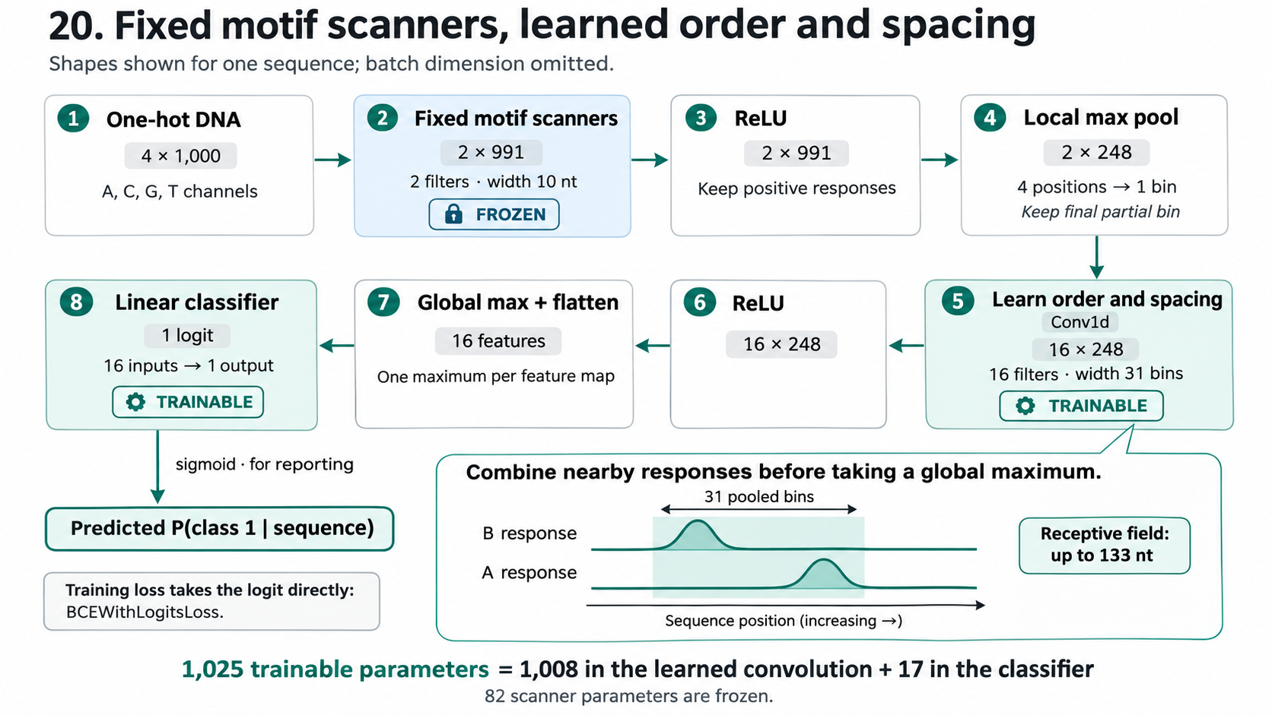
18.

Slide 36
Exercise 8
Solve a positional relationship
One Hot Encoding
MLP+ReLU
Convolutional Neural Network (fixed motif)

Slide 37
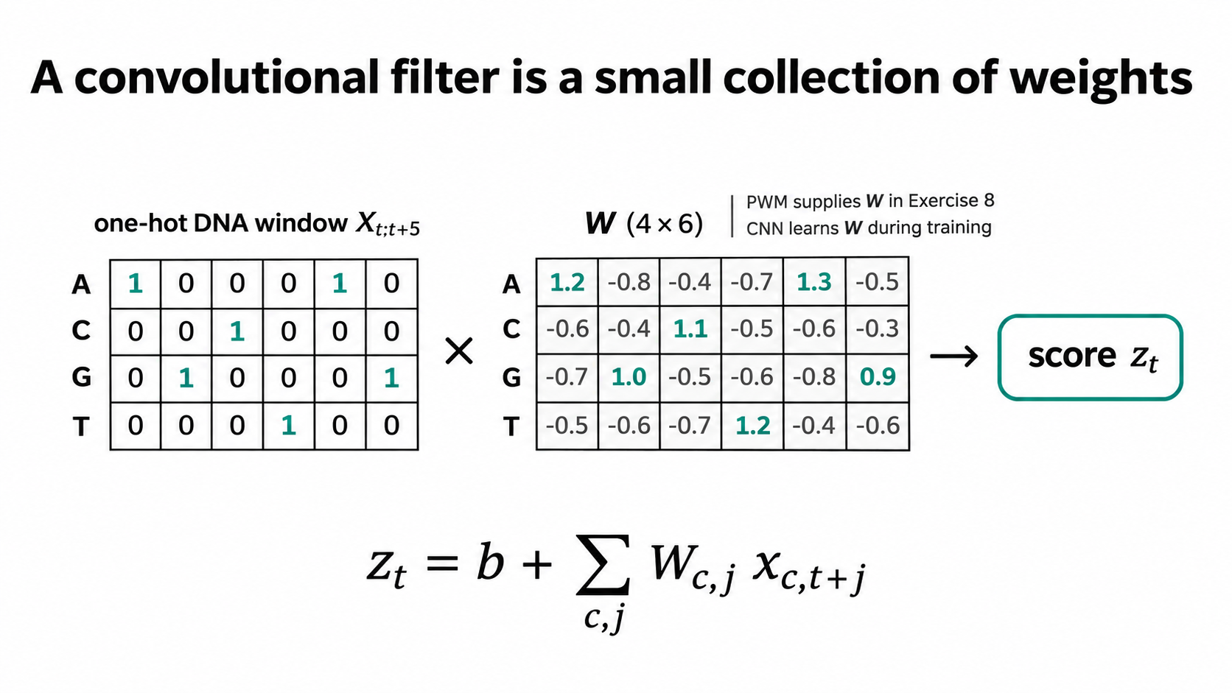

Slide 38
Forward pass: The CNN predicts P(promoter)
32 filters · 15 nt each
Learned feature combinations
Pooled features
[ 1.24, 0.18, 0.92, ... ]
True label y = 1
One-hot
DNA
Conv 1
+ ReLU
Local max
pooling
Conv 2
+ ReLU
Global max
pooling
Dense
(linear)
Sigmoid
p = 0.73
Loss
L = 0.315
Forward: use current weights to calculate the probability and loss.

Slide 39
Backpropagation: Learning which weights to change
32 filters · 15 nt each
Learned feature combinations
Pooled features
[ 1.24, 0.18, 0.92, ... ]
True label y = 1
One-hot
DNA
Conv 1
+ ReLU
Local max
pooling
Conv 2
+ ReLU
Global max
pooling
Dense
(linear)
Sigmoid
p = 0.73
Loss
L = 0.315
Gradient flows backward through every stage
Backprop calculates gradients; Adam updates Conv 1, Conv 2 and Dense.

Slide 40
Exercise 9
Solve a positional relationship
One Hot Encoding
MLP+ReLU
Convolutional Neural Network (learned motif)

Slide 41


Slide 42
miRNA
Target RNA
Task: Given a microRNA sequence and a potential target site sequence, what is the probability that the microRNA strongly binds the target?
miRNA
Target site

Slide 43
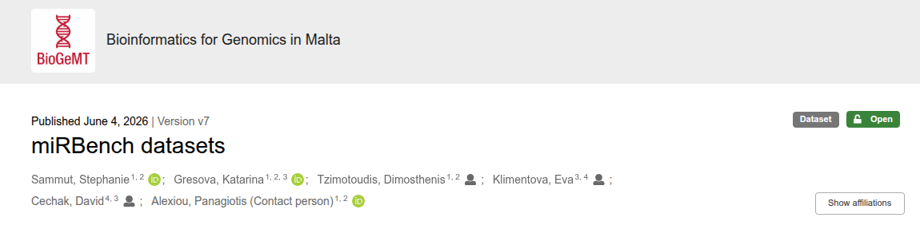
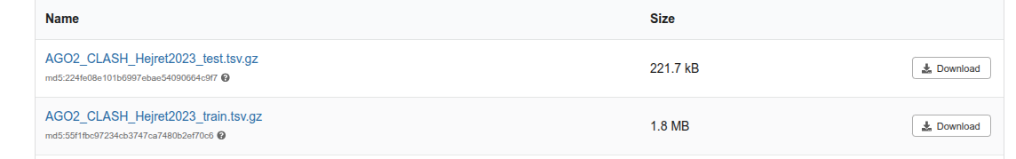
https://zenodo.org/records/20540907

Slide 44
Task: Build a predictor
Get Data
Decide on data representation and modeling
Train a predictor
Build an evaluation tool (Area Under Precision Recall Curve)
Exercise 10

